Slide 1

深度学习框架与大规模深度学习训练系统
——来自商汤的解决方案
张行程
商汤科技深度学习框架核心开发者

Slide 2















SenseTime in AI Industry Landscape
Fundamental Algorithm Layer
The technical barrier is high, the market scale is over 100 billion
Have chance to generate a new giant company
Parrots
Tensor Flow
Torch
Hardware Layer
capital intensive, not easy for startups to surpass
Computer Vision
Voice Recognition
Autonomous Driving
IOT
Application Layer
Market Decentralized
Computer vision technologies are the first to be monetized
Healthcare
Cloud
Robotics
Business Intelligence

Slide 3
What deep learning can do
Some examples
face recognition
face detection
image classification
object detection
semantic segmentation
image super-resolution
visual relationship detection
image captioning
activity classification & detection

Slide 4
The Success of Deep Learning
AlexNet won ImageNet
Notes:
It goes without saying that DL, as a …, has been incredibly successful in the past several years.
It has dominated a number of areas in AI, making breakthroughs everywhere: …
This slide shows the Google trend of …, which reflects how popular …
We can see deep learning was just a niche no one paid attention to
In year 2012, an important event happened …

Slide 5

Deep Learning Enables AI Breakthroughs
Facial Recognition
Voice Recognition
Image Recognition
Game Playing
Deep Learning
Enabling machines to acquire knowledge and skills
inducted from massive data
Autonomous Driving

Slide 6
What Lead to the Success?
Notes:
Why is deep learning so hugely successful? What are the reason behind such success?
Analog …
In order to send the rocket to the sky, you need two things: fuel & engine
How powerful the engine is, to a large extent, is determined by the model capacity.
Expressive power <-- depth of the network

Slide 7
The Race of Network Depth

Slide 8
Challenges for training deep models
Dense computation requirement
To train ResNet 50: 1000,000 T FLOP
14 days on NVIDIA M40 GPU
Limited GPU memory
Largest memory available: Quadro M6000 24G
Requirement increase linear with model depth

Slide 9
More Challenges
Heavy concurrent small file access
~10T image data will be randomly accessed
Images size 10k ~ 500k
Throughput should up to 2k images / sec
Large communication load
Exchange 500 MB/s among every computation node

Slide 10
Technical Infrastructures
Cluster
Platform
DeepLink
A large-scale cluster platform that can accommodate multiple concurrent tasks.
Learning
Framework
Parrots
An efficient & scalable learning framework for performing the model training & testing.
Computation
PPL
High performance computational functions or hardware modules that make each step fast
Notes:
I have been describing all the benefits, all the good aspects of deep models.
However, I would like to invite everyone here to pay attention to an important fact:
Training a deep network is not as simple as it appears to be on a textbook or a tutorial.
To make this happen, we need a full stack of components behind the scene.

Slide 11
Our Integrated Solutions
Deep Link
Storage
Communucation
Scheduling
Monitoring
Parrots
Parrots
CPU
PPL
CPU
PPL
GPU
GPU
GPU
GPU
GPU
GPU
GPU
GPU
Notes:
This is the picture of our integrated solution.
Let’s consider a large cluster system, which combines multiple machines, which we call computing nodes, via interconnects between them.
Within each node, there is a CPU, and usually it also contains one or multiple GPUs.

Slide 12
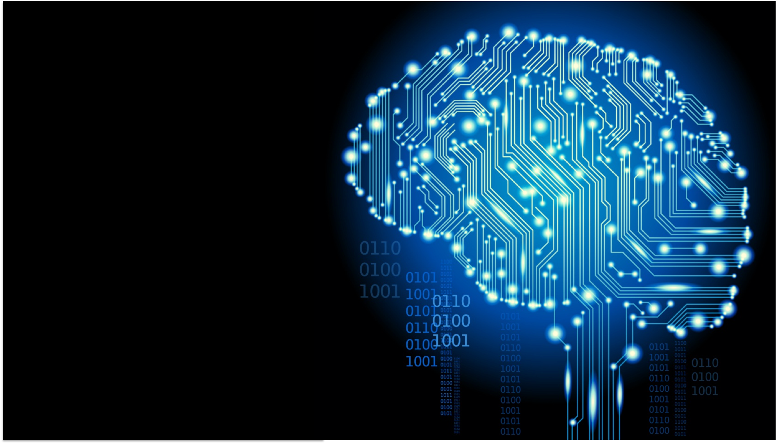
PPL
A library of highly optimized computational modules.
1
Parrots
A deep learning framework that is efficient, scalable, and flexible.
2
DeepLink
A large-scale cluster platform designed for deep learning.
3
Notes:
In the following section, we are going to introduce the three parts of our solution in turn.
They are …
First of all, ...

Slide 13
Layers
The efficiency of a deep network essentially depends on how fast we can compute:
Convolution
Matrix product
Pooling
Activation
Batch normalization
Others …
PPL (Parrots Primitive Library) is to provide highly optimized functions for such computation.
Notes:
We know that a deep network is often formulated as multiple layers of computations.
From the input end to the output end, the network needs to go through ….
PPL is to ...

Slide 14
PPL Editions
PPL has multiple editions for different architectures
X86
ARM
CUDA
OpenCL
Support all common CNN functions.
Support Windows, Linux, and Mac OS X.
Support ISA: AVX, AVX2, and 64-bit processors.
Support all common CNN functions.
Support iOS, Android, Linux, and Windows.
Supported ISA: ARMv7 (32bit), ARMv8 (64bit)
Supported processors:
ARM Cortex-A
iPhone 4x – 6x
All qualcomm
Support all common CNN functions.
Support Windows, Linux, and Mac OS X.
Support all NVidia GPUs
GeForce
Tesla
Tk1
cuDNN + our own implementations
Mainly to support embedded devices.
Support all common CNN functions.
Supported devices:
Qualcomm adreno GPU
ARM Mali GPU
Performance comparable to the ARM edition.
Notes:
Particularly, PPL provide different editions for different architectures:
X86, ARM, CUDA, and OpenCL.

Slide 15
PPL X86 vs. Intel MKL

Slide 16
PPL ARM vs. Caffe ARM
Notes:
Mobile devices is also an important area that we invest heavily on.
So we take a lot of efforts to optimize the computational routines for ARM.

Slide 17
PPL
A library of highly optimized computational modules.
1
Parrots
A deep learning framework that is efficient, scalable, and flexible.
2
DeepLink
A large-scale cluster platform designed for deep learning.
3

Slide 18
Popular Frameworks
Limited support of multi-GPU.
No support of distributed training.
Too restricted, difficult to support novel models.
Limited support of distributed training.
Very flexible but you have to write low-level codes – poor productivity.
By Google
Designed for high scalability
Too resource-demanding and performance remains sub-optimal.
Designed for improved user experience & flexibility.
Pure python.
Limited efficiency & scalability.

Slide 19
Parrots
A New Deep Learning Framework for the Future
Efficiency
Automatic parallelize operations at different layers by dependency analysis
I/O and communication latency hidden via careful coordination
Highly optimized memory reuse
Scalability
Devised for distributed learning on heterogeneous architectures from the very beginning
Various communication schemes optimized for different environments
Builtin support of RDMA
Productivity
Battery included.
Mainstream computer vision frameworks and pre-trained models are provided out of box.
One network, multiple flows.
Modularized design: compose large frameworks with model-wares.

Slide 20
User Scenario
progress monitor
Model specification
training data
data source
iterations
learning rate settings
……
Model params
Session specification

Slide 21
Efficiency
Small file IO
GPU memory usage
Training speed

Slide 22
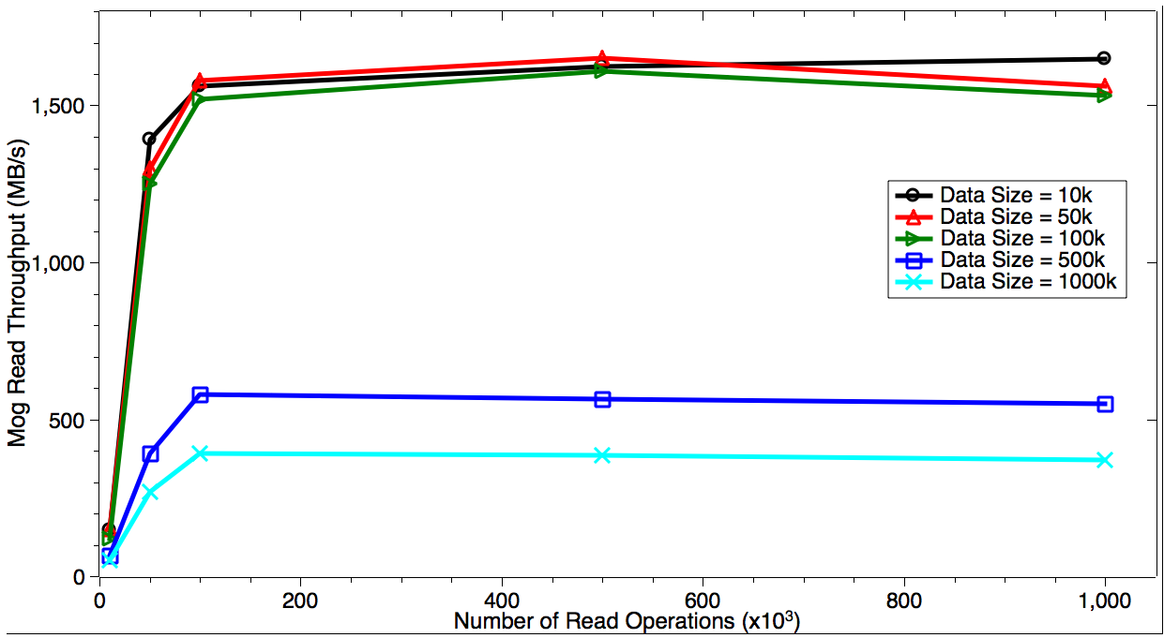
Highly concurrent Small File Access

Slide 23
Comparison on Memory Consumption

Slide 24
Comparison on Single-GPU Speed
* Higher is better

Slide 25
Comparison on Multi-GPU Speed

Slide 26
Scalability
single node
multiple nodes

Slide 27
Comparison on Weak Scaling

Slide 28
Comparison on Strong Scaling

Slide 29
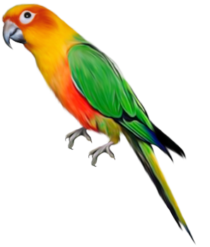
Behind the Scene
Cross-module
Parallelization
Light-weight
Computing Flow
Intermediate
Byte-code compilation
Structure-aware
Memory reuse
Parrots
Deep Learning
Virtual Machine
Distributed
Dynamic Cache
Adaptive
Learning Control

Slide 30
Multi-level Cache
GPU Cache
Host Memory Cache
SSD Cache
HDD Cache

Slide 31

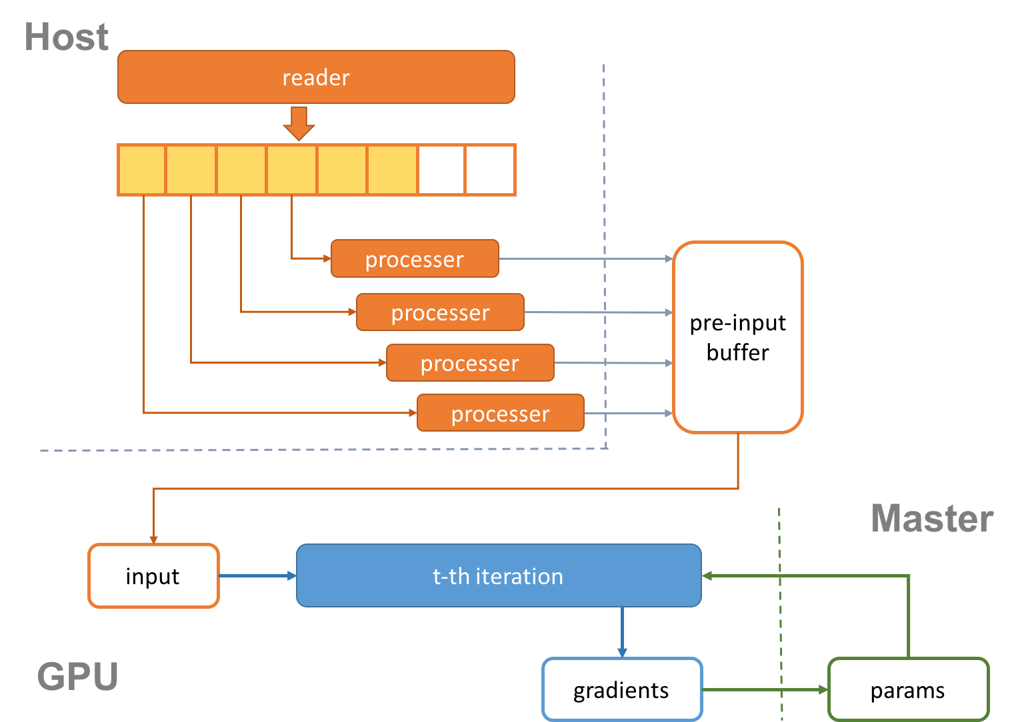
Serial Loading Parallel Processing (SLPP)
Rationales
Factor 1
Factor 2
Overlap data loading, processing, and on-GPU computation via proper scheduling.
Serial I/O often yields higher throughput, while in-memory processing can be done in parallel.
Maximum utilization of GPU, CPU, and I/O.
Overlap
Factor 3
Factor 4

Slide 32
Dependency-based Memory Reuse
Conventional
Ours
v g
v
g
v g
v
g
v g
v
g
v g
v
g
v g
v
g

Slide 33
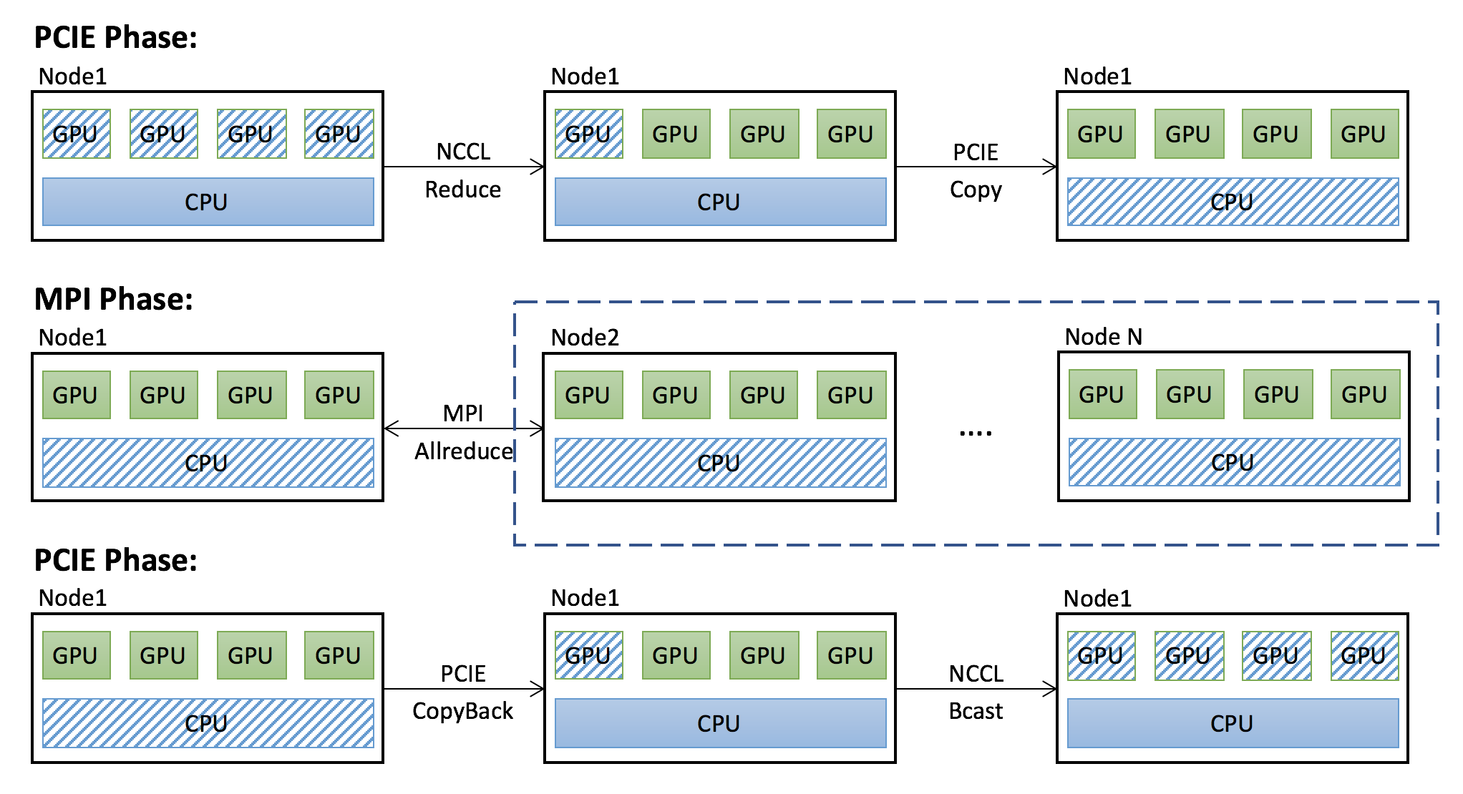
Two-level Communication
To achieve high scalability

Slide 34
Feature Matrix
 | Parrots | Caffe | TensorFlow | Chainer
Multi-GPU support | Y | Y | L | L
Distributed training (multi-nodes) | Y | N | L | N
Model parallelism | Y | N | L | L
Concurrent feeding | Y | N | Y | N
Parallel data preprocessing | Y | N | Y | N
RNN support | Y | N | Y | Y
Variable input size | Y | Y | Y | Y
Dynamic network structure | Y | N | Y | Y
Partial flow execution | Y | N | Y | N
Block composition | Y | N | Y | Y
Customized layer | Y | Y | Y | Y
Customized updating policy | Y | N | Y | Y
Interoperability with Caffe | Y | Y | N | N
L: low-level support. Non-trivial coding is required to make it happen.

Slide 35
Overall Comparison
 | Parrots | Caffe | TensorFlow | Chainer
Efficiency | High | Fair | Low | Fair
Scalability | High | Low | High | Low
Extensibility | High | Low | High | Fair
Productivity | High | Low | Fair | High

Slide 36
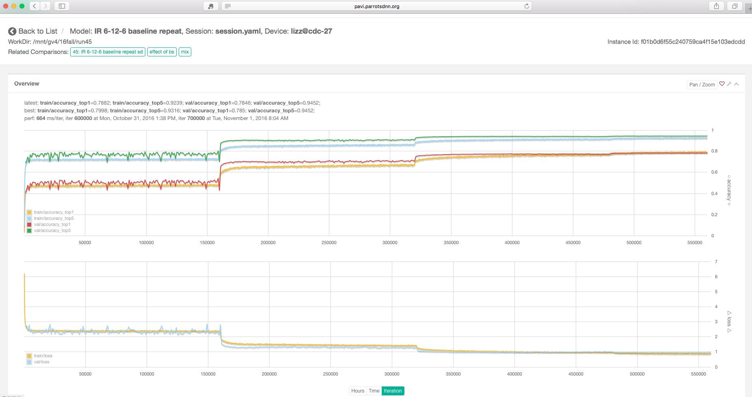
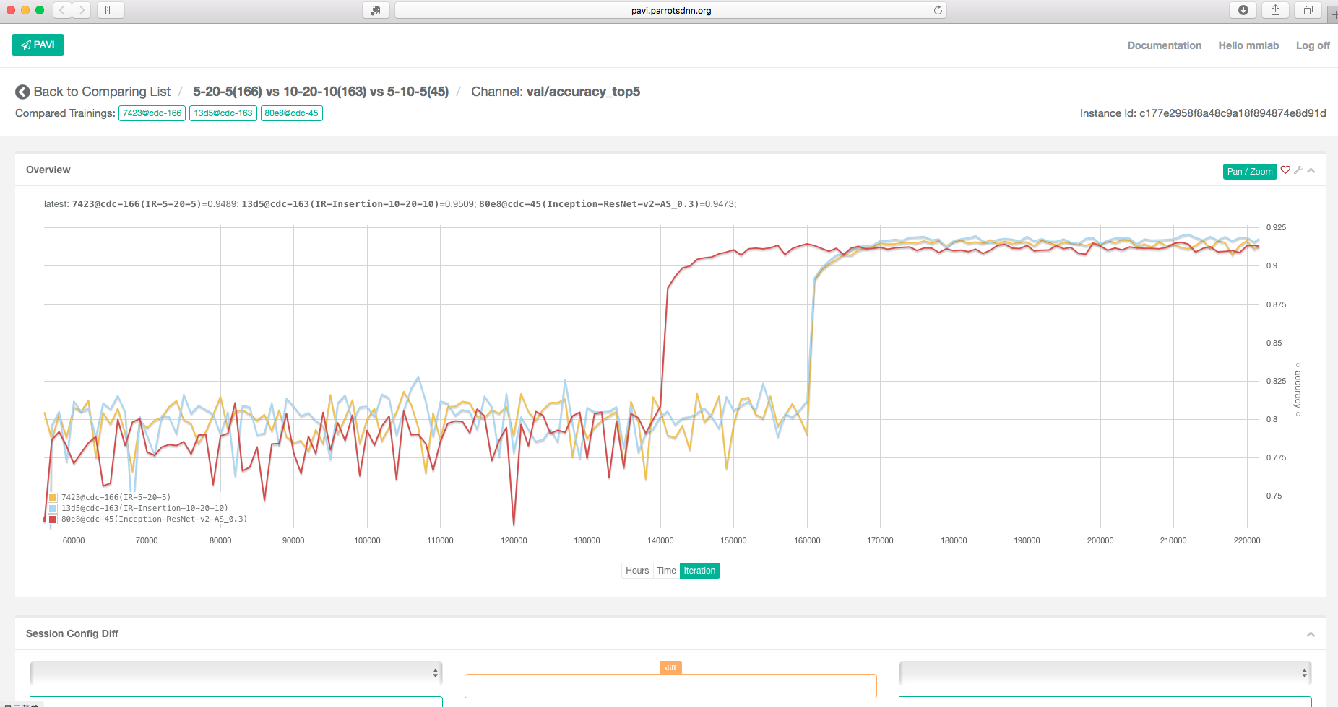
Web UI for Training Monitor

Slide 37
PPL
A library of highly optimized computational modules.
1
Parrots
A deep learning framework that is efficient, scalable, and flexible.
2
DeepLink
A large-scale cluster platform designed for deep learning.
3

Slide 38
DeepLink Clusters
Designed for Deep Learning
Maximize respective strengths while ensuring optimal cooperation.
Software Hardware Co-design
High speed interconnects
High performance GPU computing
Efficient distributed storage
High-performance Hardware
Distributed storage & cache system (optimized for small files)
Distributed deep learning framework
Task scheduling & monitoring
Customized Middlewares

Slide 39
Challenges
Interconnects at multiple levels
GPUs, Nodes, Sub-networks
Distributed data
Random access becomes particularly difficult
Scale vs. Stability
Failures of individual nodes/links
Human resources
Engineers who understand both Deep Learning & HPC are difficult to come by

Slide 40
Overall Architectures
Deep Learning Monitoring
Parrots
Parrots Learning Framework
PPL Library
Communication Module
DeepLink
Cache
Backup
Virtualization
Cluster monitoring & management
GPU Clusters
Storage

Slide 41
High-speed interconnects
Based on infiniband
A protocol designed to meet high communication demand
Low latency, high throughput (56 – 200 Gb/s)
Scale expansion by stacking switches

Slide 42
Versatile Storage Support
Different strategies for different data
Images
Text
Unstructured
Large number of small files
require random access
Aggregate small text documents into large files
Use NoSQL databse, e.g. BigTable and HBase

Slide 43
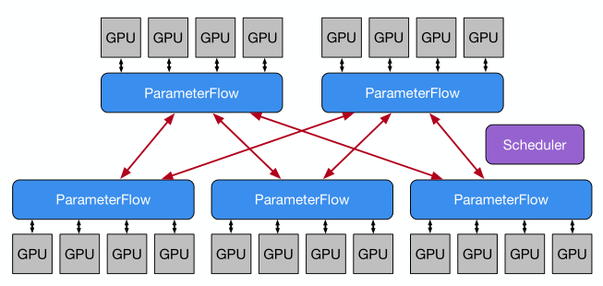
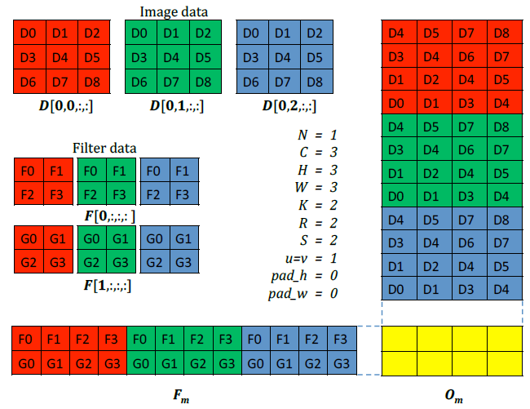
Customized Middlewares
Parameter Flow
High-performance Convolution

Slide 44
Excellent Stability
Continually working for months
Even with adverse conditions, e.g. GPU burned.
Quick restoration after catastrophe
We recovered all training sessions after a power outage due to typhoon.

Slide 45
Summary
Technical infrastructure is crucial to the success of deep learning applications
We have solutions across the entire stack
PPL: computation modules (supporting CPU, GPU, and embedded devices)
Parrots: deep learning framework (efficient, scalable, and flexible)
DeepLink: sophisticated and versatile cluster training platform
Top-notch performance and reliability

Slide 46
Q & A
Thank you

